Slide 1

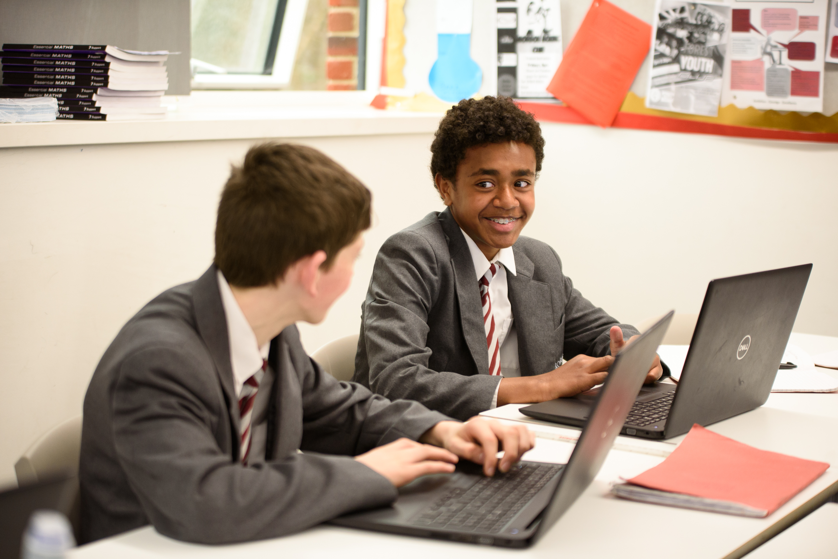
Year 8 Information Evening 2023
Ambition, Courage, Excellence

Slide 2
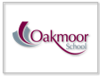
Attendance
Excellent attendance is linked to high achievement.
Students with a higher percentage attendance achieve better grades.
Good attendance is a life skill and will be needed in terms of the future within education and the world of work.
Ambition, Courage, Excellence

Slide 3
Evening Aims
To provide students, parents & carers with information on...
A picture of the whole school and subject specific curriculum at Oakmoor and what to expect for Year 8 and beyond
how we can work together to safeguard your/our children
additional extra-curricular opportunities that will be available in the future which will extend learning and enrich the lives of our students
Ambition, Courage, Excellence

Slide 4
Class Learning at Oakmoor
Demonstrate our key values of Ambition, Courage and Excellence in all you do.
Follow our Golden Rules:
- Do as you are asked
- Treat others with respect
- Strive for excellence in your work
Ambition, Courage, Excellence

Slide 5

Home Learning at Oakmoor
Outstanding progress is being made in the classroom.
Home Learning has been shown to accelerate student progress even further.
Becoming a good Independent Learner provides you with skills for life.
Satchel One/SMHW – Parent/Carer App.
Ambition, Courage, Excellence

Slide 6
What can you expect from the Homework that we set?
Staff will set homework around the three following areas:
Preparation – We are going to cover new course content in the next few lessons, and we want you to research and find out some information so that you come to the lesson prepared with some knowledge ahead of the lesson.
Consolidation – We are setting homework that will help to cement the learning that has taken place during the lesson time.
Revision – You have a test/examination in the future and need to prepare for it.
Ambition, Courage, Excellence

Slide 7
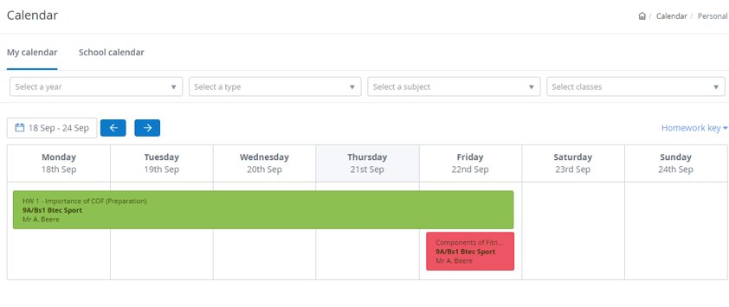
How much Homework can I expect to be doing each night?
Year 7 – 45 mins per night
Year 8 – 60 mins per night
Years 9, 10 & 11 – 1hour 30mins per night
Ambition, Courage, Excellence

Slide 8
The Importance of Reading at Oakmoor
Reading improves literacy and allows a greater opportunity to access learning. Ultimately reading enables students to access the higher-level questions in examinations.
Improves brain connectivity
Helps to develop creativity
Provides a form of escapism and can reduce stress
Lowers blood pressure and heart rate
Improves your empathy for others
Ambition, Courage, Excellence

Slide 9
What subjects will I study at Oakmoor?
Key Stage 3 – Years 7 & 8
English – 8
Mathematics – 8
Science – 8
Futures – 1
Technology – 2
Computing – 2
MFL – 3
History – 3
Geography – 3
Physical Education – 4
Religious Education – 2
Art – 2
Performing Arts – 4
Total number of lessons = 50 over two weeks
Key Stage 4 – Years 9, 10 & 11
Year 9 Year 10 Year 11
English – 10 9 10
Mathematics – 10 10 9
Science – 9 10 10
Option 1 – 4
Option 2 – 4
Option 3 – 4
Option 4 – 4
Non-examined content
Physical Education – 4
Religious Education – 1
Total number of lessons = 50 over two weeks
Ambition, Courage, Excellence

Slide 10
The Options Timeline
KS3 Information Evening – 21st Sept
An introduction to options
Exp Day 3 – 7th February
Careers
Options
Assembly from Mr Beere
Year 8 Parents Evening (J,K,L,M) Thursday 1st February 4:30-7:30pm
Year 8 Parents Evening (N, O & P) Thursday 8th February 4:30-7:30pm
Options Evening – Thursday 29th February (6:00-8:00pm)
Options Electronic Form Deadline - Thursday 14th March
Staff contact home where there are potential curriculum issues. Deadline to resolve – Thursday 21st March
Final Options shared with students, parents and carers – Week Beginning Monday 8th July
Ambition, Courage, Excellence

Slide 11
Year 8 Experience Days
Day 1 – Friday 29th September
Diversity
The Law – Part 1
Day 2 – 23rd November
History of LGBTQ+
Flirting
Mindfulness
Day 3 – 7th February
Careers
Options
Post-16 Options
Day 4 – Thursday 21st March ​
​ Knife Crime
The Law – Part 2
​
Day 5 – Tuesday 9th July ​
County Lines
Dental Hygiene
Gender Identity
Ambition, Courage, Excellence

Slide 12

Safeguarding at Oakmoor
What is Safeguarding?
Safeguarding means keeping a child safe from harm and abuse.
Safeguarding is the action to promote the welfare of children and protect them from harm.
Ambition, Courage, Excellence

Slide 13
Safeguarding at Oakmoor
What do we do?
Every school must have a Designated Safeguarding Lead and deputies
Every school must offer clear procedures for staff to follow if they are concerned for a student.
Ambition, Courage, Excellence

Slide 14
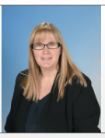
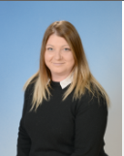
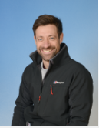
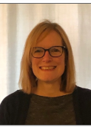
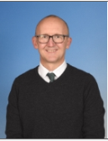
Safeguarding at Oakmoor
Who are we?
All staff are responsible for safeguarding a student.
Designated Safeguarding Lead
Mrs Evans
DDSL
Miss Riva
DDSL
Mr Beere
DDSL
Mrs Conley-Harper
  DDSL
  Mr Riley
Ambition, Courage, Excellence

Slide 15

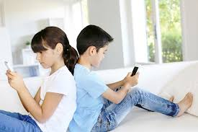
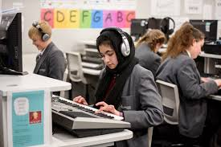
Safeguarding at Oakmoor
Filtering and Monitoring
Whilst in the classroom, students are monitored when on devices by the class teacher and/or Teaching assistant
We also have constant vigilance of internet use via a specialist monitoring platform.
Staff are alerted if anything is accessed that shouldn’t be
Conversations are then had with students and parents where needed.
Ambition, Courage, Excellence

Slide 16




Safeguarding at Oakmoor
Filtering and Monitoring at Home
Being online is integral to a young person's life.
Online technologies can provide incredible opportunities.
Exposes so many risks!
So much information at hand!
So easily accessible!
https://saferinternet.org.uk/guide-and-resource/6-smart-steps-to-snapchat-success
https://www.nspcc.org.uk/keeping-children-safe/online-safety/social-media/
Ambition, Courage, Excellence

Slide 17
Safeguarding at Oakmoor
Filtering and Monitoring at Home
Age appropriate? Facebook, Instagram, TikTok, Snapchat = 13!
Open conversations!
Clear guidelines on phone/device usage
What will your child do if something worrying happened whilst on a phone/device?
Being together more online.
https://saferinternet.org.uk/guide-and-resource/6-smart-steps-to-snapchat-success
https://www.nspcc.org.uk/keeping-children-safe/online-safety/social-media/
Ambition, Courage, Excellence

Slide 18
Safeguarding at Oakmoor
Road Awareness
Not on Phones
One ear Bud!
Not talking to Strangers
Walking with Friends
Safety on the bus
Report to Mentor
Safe cycle/scooter and equipment
Journey to School
Ambition, Courage, Excellence

Slide 19

Safeguarding at Oakmoor
Routine – Wellbeing
Good Sleep
Good food
School Work
Homework
Balance
Healthy Habits
Care
Ambition, Courage, Excellence

Slide 20

Safeguarding at Oakmoor
Phones should be off during the school day
Have an agreement on usage
Parental Controls
Keep private information private
Understand how to manage social networking
Ambition, Courage, Excellence

Slide 21

Everyone Matters at Oakmoor
Ambition, Courage, Excellence

Slide 22


Team Oakmoor
Ambition, Courage, Excellence

Slide 23

Choices……the harder you work now, the more choices are open to you!
What next…?
Ambition, Courage, Excellence

Slide 24
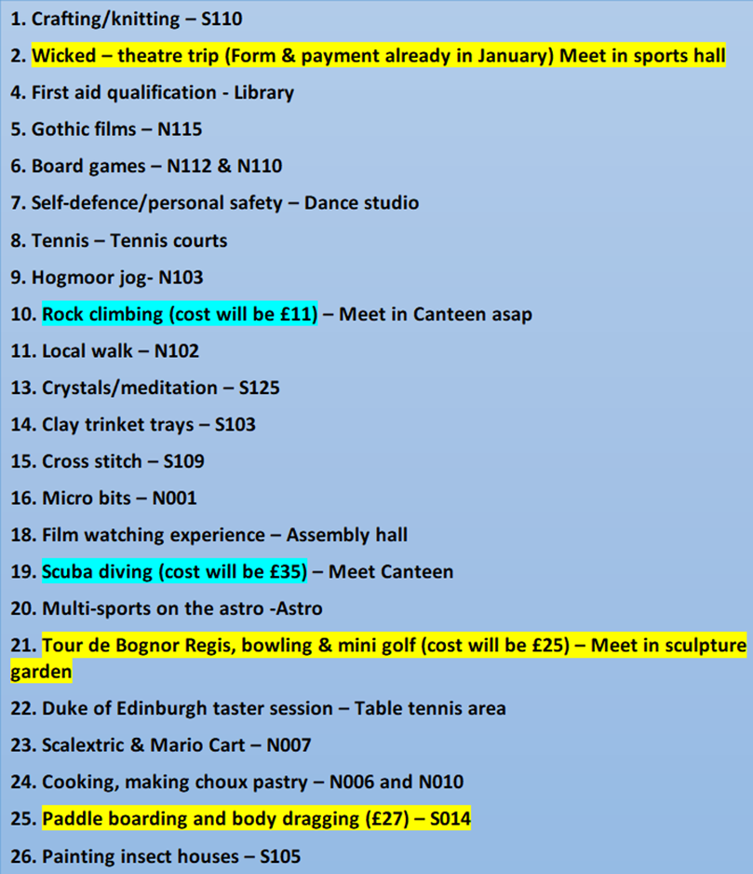
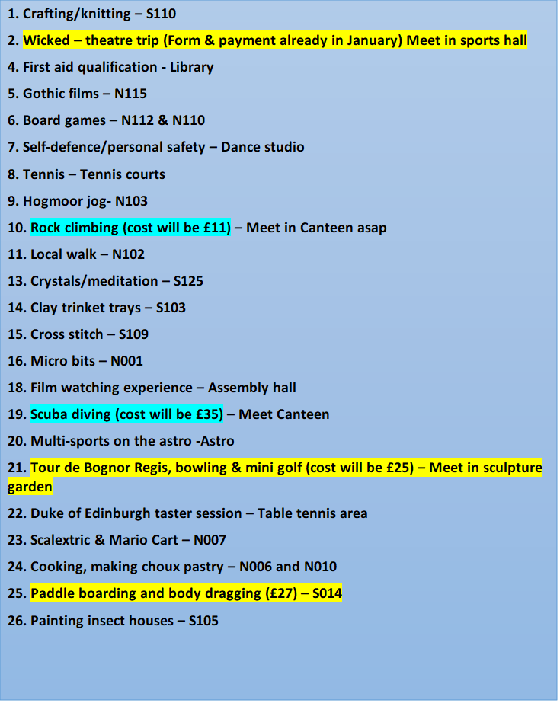
Enrichment Day – Wed 17th July 2024
Ambition, Courage, Excellence

Slide 25
Enrichment Day – Wed 17th July 2024
Ambition, Courage, Excellence

Slide 26
Future Opportunities
Surrey Storm Netball and Surrey Scorchers Basketball
Theatre Trips
Tate Modern
Future Art Residential Trip
Duke of Edinburgh – Currently available for Year 10. Looking to move bronze award down to Year 9 and Silver Award for Year 10.
Enrichment Day
Ardeche Trip – Outdoor Adventure, kayaking and camping out under the stars. Summer 2025
Ski Trip
Ambition, Courage, Excellence

Slide 27
FAQs
Lockers
Satchel One – Homework App/Parent Account
After School Clubs
Parking
Lunchtime
Satchel or Seneca?
Students in uniform outside of school hours
Children with SEND
Sports Clubs and Representing Teams
Feedback and marking
Trips
Bullying
Ambition, Courage, Excellence

Slide 28
Thank you for listening
What’s next this evening?
From now until 8:00pm – An opportunity to visit departments and talk with teachers about subject curriculum
Refreshments are available in the dining hall until 8:00pm.
Ambition, Courage, Excellence

Slide 29
      Department Room List
Art – S103
Computing – N004
English – N111​
Geography – S111
History – S110
Mathematics – N103​
MFL – N118
Performing Arts – E010
Physical Education – S014
Religious Education – S110
Science – S018
Technology – N007
Ambition, Courage, Excellence

