Slide 1

Welcome to
Year 10 Information Evening 2023
Making the most of this year!
Ambition, Courage, Excellence

Slide 2
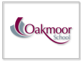


Why are we here this evening?
What we are not….
What we are….
To help prepare students, parents & carers for the year ahead.
To provide information on Post 16 pathways and procedures.
Ambition, Courage, Excellence

Slide 3
Journey through Year 10
Parent information evening
Year 10 exams
28 September
8 – 19 April
Reviewing exams
Year 10 Parents' Evening
Summer term
Year 10
18 January
Year 11
September
Working with Elevate Education
January
3 stage revision programme
January - April

Slide 4

Safeguarding at Oakmoor
What is Safeguarding?
Safeguarding means keeping a child safe from harm and abuse.
Safeguarding is the action to promote the welfare of children and protect them from harm.
Ambition, Courage, Excellence

Slide 5
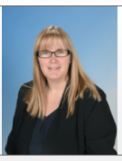
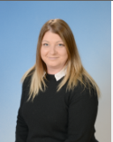
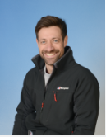
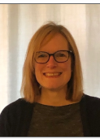
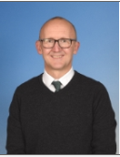
Safeguarding at Oakmoor
Who are we?
All staff are responsible for safeguarding a student.
Designated Safeguarding Lead
Mrs Evans
DDSL
Miss Riva
DDSL
Mr Beere
DDSL
Mrs Conley-Harper
  DDSL
  Mr Riley
Ambition, Courage, Excellence

Slide 6
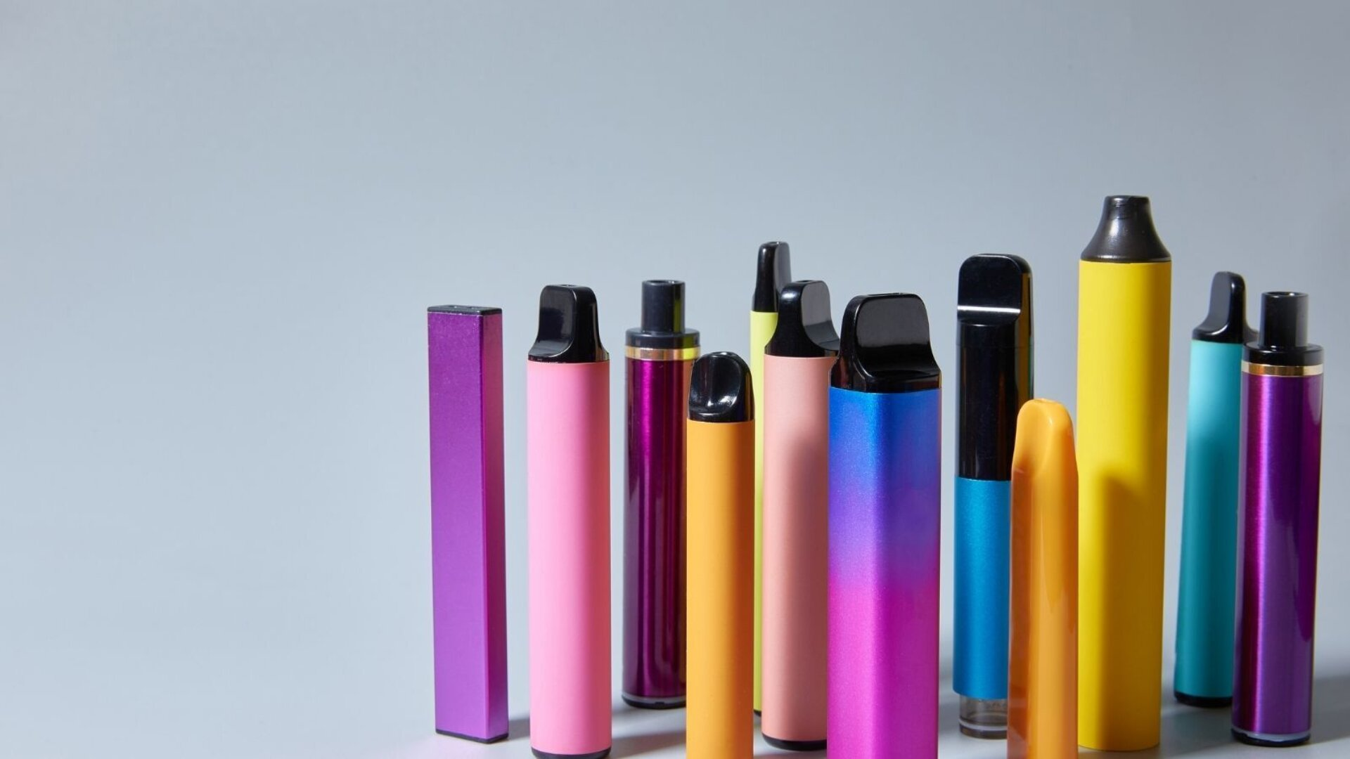

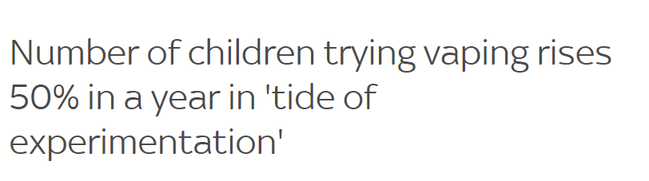
Safeguarding at Oakmoor
Vaping
Not allowed in school.
Check pencil cases and bags
Look for highlighter vapes.
Monitor shopping tendencies – so easily accessible.
Thank you for reporting.
May 2023
https://ash.org.uk/
Ambition, Courage, Excellence

Slide 7

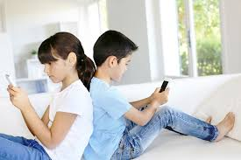
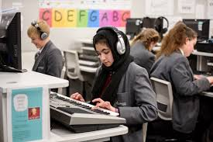
Safeguarding at Oakmoor
Filtering and Monitoring
Whilst in the classroom, students are monitored when on devices by the class teacher and/or Teaching assistant
We also have constant vigilance of internet use via a specialist monitoring platform.
Staff are alerted if anything is accessed that shouldn’t be
Conversations are then had with students and parents where needed.
Ambition, Courage, Excellence

Slide 8




Safeguarding at Oakmoor
Filtering and Monitoring at Home
Facebook, Instagram, TikTok, Snapchat –What date of birth?
Open conversations!
Clear guidelines on phone/device usage
What will your child do if something worrying happened whilst on a phone/device?
Being together more online.
https://saferinternet.org.uk/guide-and-resource/6-smart-steps-to-snapchat-success
https://www.nspcc.org.uk/keeping-children-safe/online-safety/social-media/
Ambition, Courage, Excellence

Slide 9

Safeguarding at Oakmoor
Ambition, Courage, Excellence

Slide 10
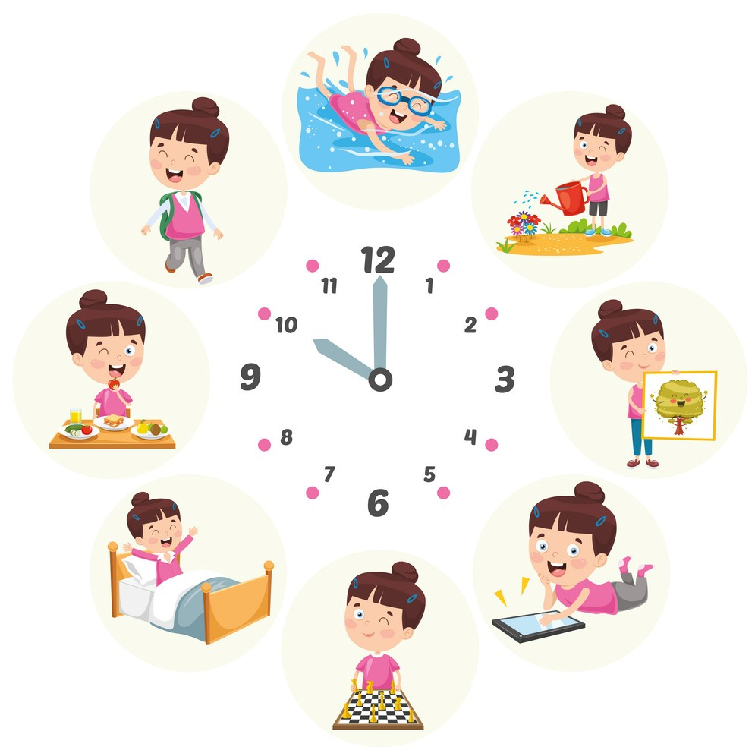
Safeguarding at Oakmoor
Routine – Wellbeing
Good Sleep
Good food
School Work
Homework
Balance
Healthy Habits
Care
Ambition, Courage, Excellence

Slide 11
Supporting learning
Revision Sharepoint
Elevate Education
Revision workshops
Three step revision
After school intervention
Attendance | Class learning | Home learning
Higher attendance= higher grades | Golden rules | Homework increases achievement 1.5 hours a night

Slide 12
3 stages of revision
1
Note taking
For example:
Note taking
Mind maps
2
Recall
For example:
Flash cards
Memory recall activities
3
Exam practice
For example:
Answer exam style questions
Complete past papers and self mark
Sit Y10 exams

Slide 13
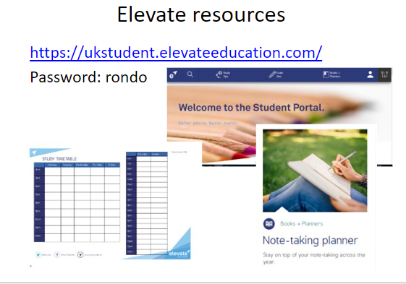
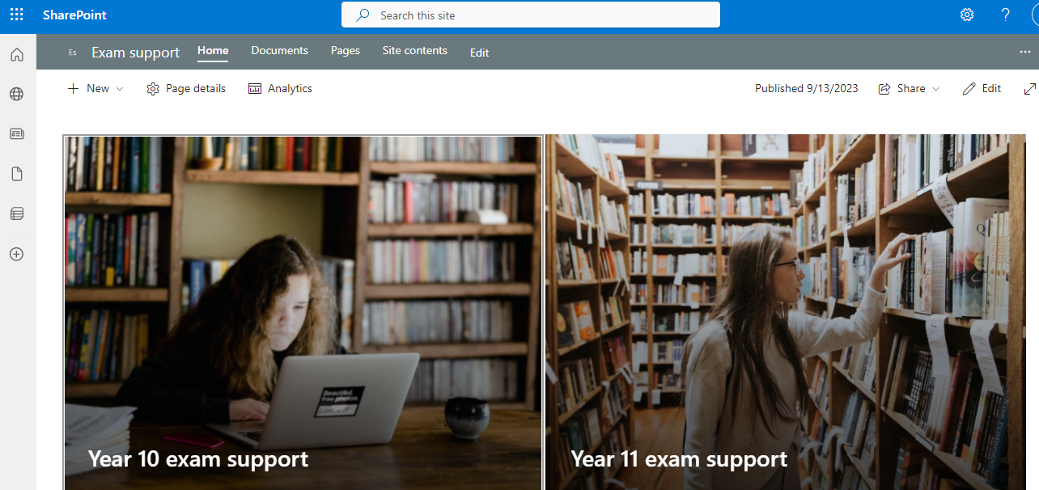

Slide 14

Exam wellbeing
Positive thinking/growth mindset
Sleep
Exercise/balanced diet/water
Relaxation, regular breaks
Fresh air – get outdoors
Social time
Talking

Slide 15
Common misconceptions…
Common misconceptions
I’m working harder than…
No-one else is revising
I don’t need to revise for Y10 exams. I’ll just do it for the real thing

Slide 16
What can you do at home?
Work with us.
Look after yourselves too!
Keep talking.
Provide the quiet workspace.
Monitor wellbeing and balance.
Keep in touch.
Teachers
&
Support Staff
Students
Mentors
&
APLs
Parents
&
Carers

Slide 17
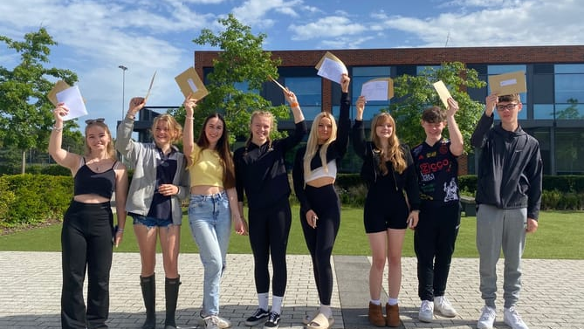
“Coming to the end of year 11 was stressful, but everyone stuck together throughout. I wouldn’t have wanted to do my GCSEs anywhere else.”

Slide 18

What next…?
It's never too early to start thinking about your future
It's never too late to go in a different direction
Ambition, Courage, Excellence

Slide 19

Choices……the more you make of Y10, the more choices are open to you!
What next…?
Ambition, Courage, Excellence

Slide 20
Transition to Post 16
Which Qualifications?
What are you good at?
A levels
  Choose three or four subjects for a personalised combination
  Exam based assessment
BTEC or other vocational qualifications
  Study different aspects of one vocational area
  Mainly coursework-based assessment
  Level 3 courses are the equivalent of three A levels
What do you enjoy?
A levels & vocational qualifications
  Combine two A levels and one vocational course
Apprenticeships
  A combination of work and study
  Typically, four days work with one day at college
  Earn as you learn
What do you need?
T-Levels
  Launched in 2020 in collaboration with employers to meet needs of industry
  Equivalent to 3 A levels
  80% in classroom, 20% in workplace
Ambition, Courage, Excellence

Slide 21













Transition to Post 16
Ambition, Courage, Excellence

Slide 22
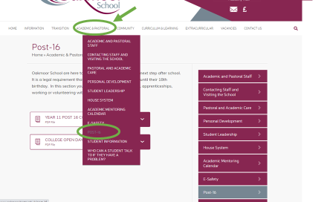
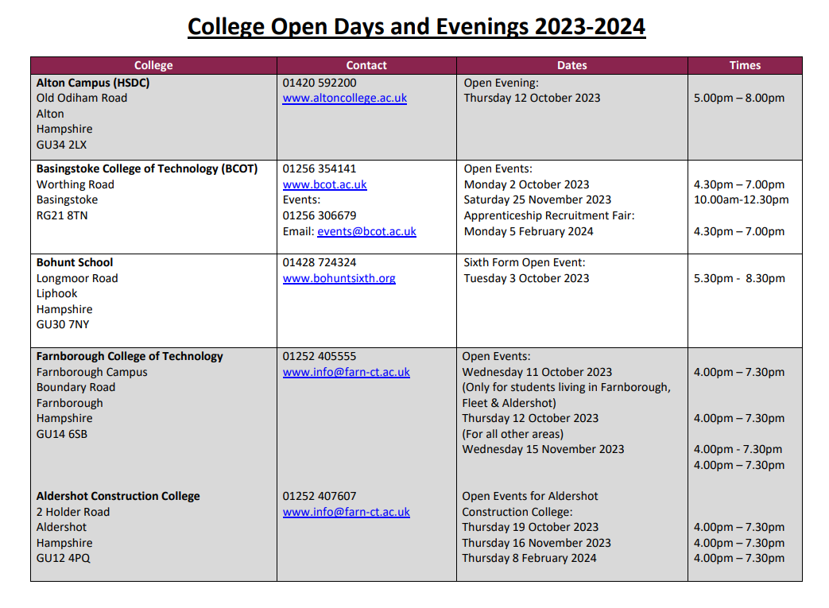
College Open Evenings
Ambition, Courage, Excellence

Slide 23
What's next this evening?
An opportunity to speak to staff from some of our local Colleges.
An opportunity to speak to Spencer Chisholm, our School Careers Advisor.
Staff along with refreshments and are available in the dining hall until 8:00pm.
Ambition, Courage, Excellence

